Slide 1
ZaraMove
Group 07- Semantic Web & Web of Linked Data

Slide 2
Integrantes
Jorge Ayuso Fernández
Cristian Berrío Aroca
Enzo Ferey
Mario Martín López
David Rabano Neila

Slide 3
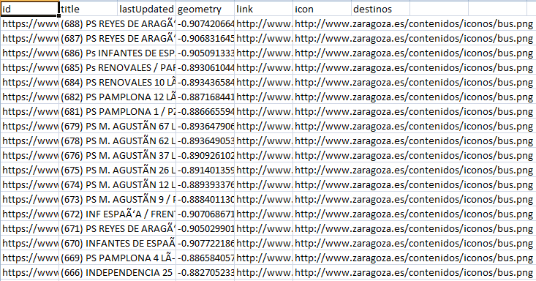
HandsOn1 (Finding datasets)

Slide 4
HandsOn2 (Dataset Analysis & Definition)
Propietario : Excmo. Ayuntamiento de Zaragoza
Licencia libre de reutilizar :
mencionar origen de los datos
no desnaturalizar el sentido de la información

Slide 5
HandsOn2 (Dataset Analysis & Definition)
Resource Naming Strategy
http://www.zaramove.es/transportes/resource/<className>#<identifier>
http://www.zaramove.es/transportes/ontology/<ontologyName>#<propertyName>

Slide 6
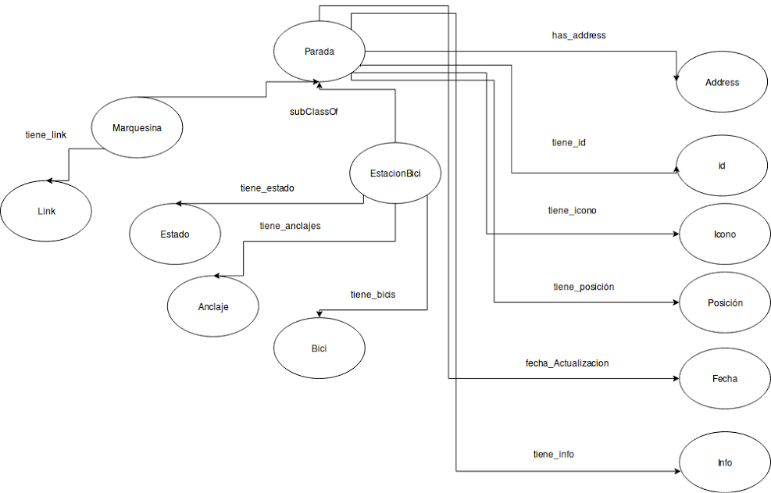
HandsOn2 (Dataset Analysis & Definition)

Slide 7
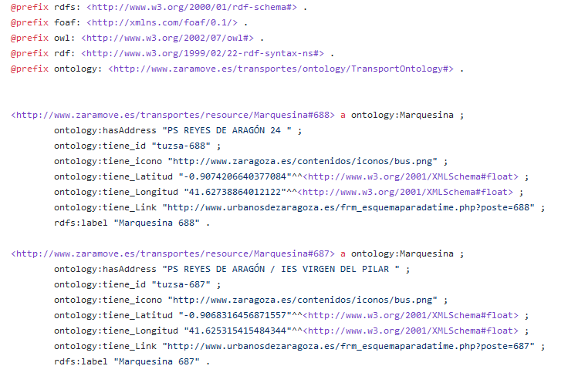
HandsOn3 (RDF Generation)

Slide 8
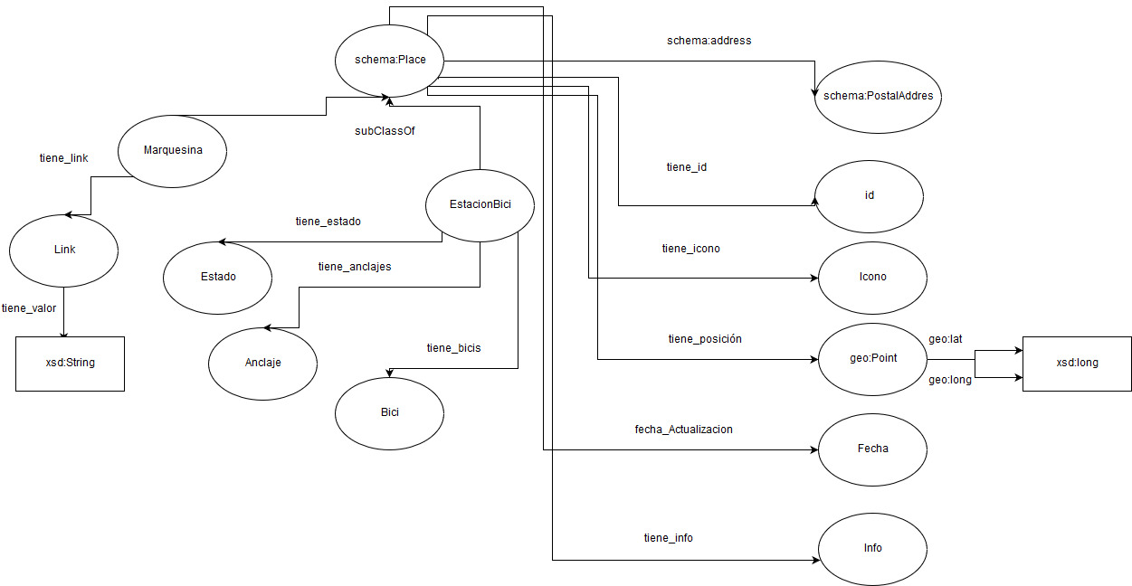
HandsOn4 (Reusing vocabularies)

Slide 9
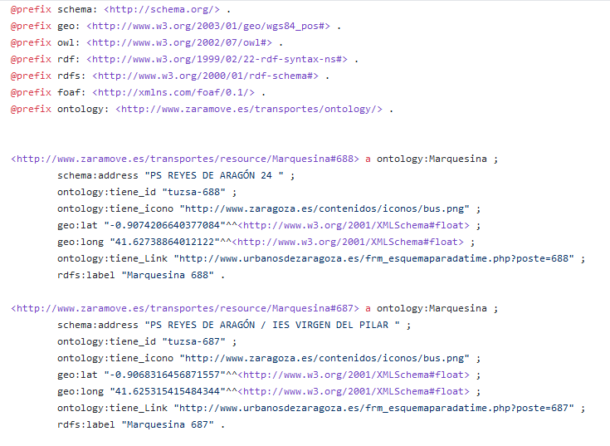
HandsOn4 (Reusing vocabularies)

Slide 10
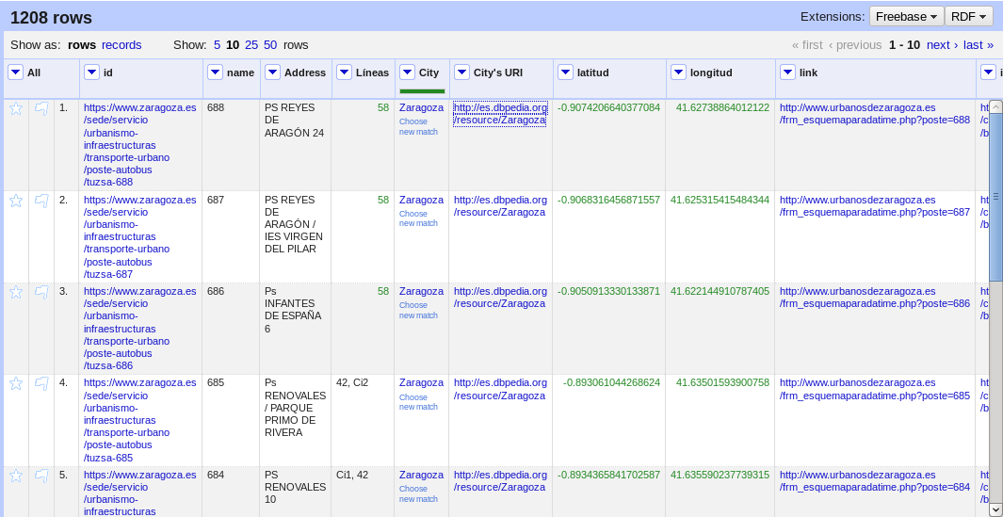
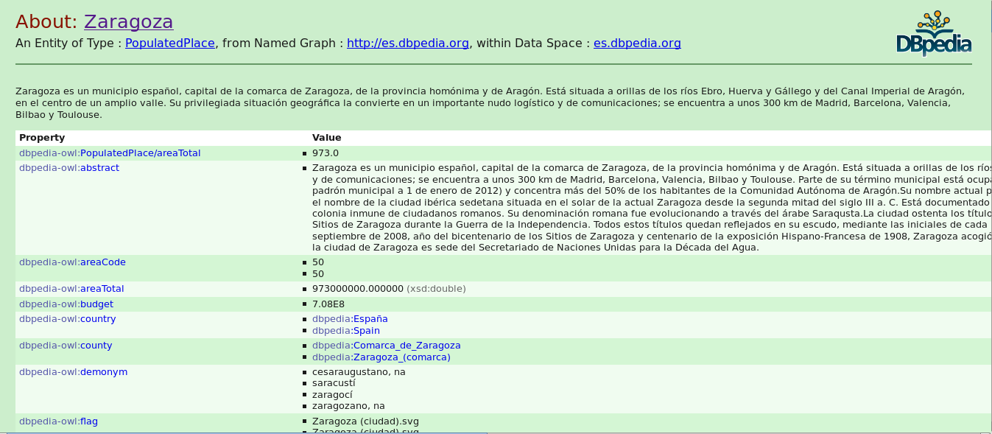
HandsOn5
(Data Linking)

Slide 11
APP - Demo

